Slide 1
Drawing Basics
Mr Mack

Slide 2
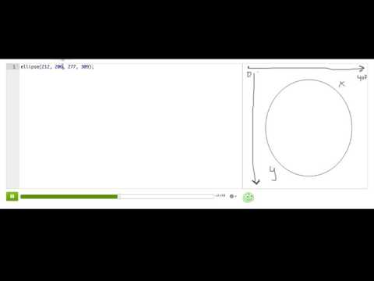
Making drawings with code

Slide 3
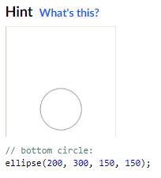
Practice: Simple snowman
In this challenge, you'll draw a snowman using the ellipse() command.
Start off by making a circle, for the bottom of the snowman, with an ellipse() command. This should be the first ellipse() command in your program.
We've suggested some good values for the ellipse() command in the hint code, but you can change those numbers around, as long as the bottom of your snowman is a circle near the bottom of the canvas and it's not too small!
Step 1: The bottom

Slide 4
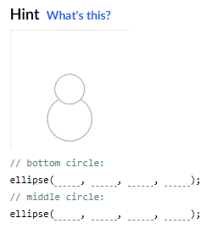
Practice: Simple snowman
Now draw a second circle, for the middle of your snowman, using another ellipse() command. This should be the second ellipse() command in your program.
Make sure that your second circle is a little smaller than the bottom circle, and that it sits on top of the bottom circle.
Step 2: The middle

Slide 5
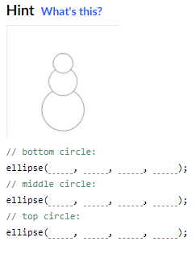
Practice: Simple snowman
Now draw a third circle, for the head of your snowman, using another ellipse() command. This should be the third ellipse() command in your program.
Make sure that your third circle is a little smaller than the middle circle, and that it sits on top of the middle circle, because that's what heads do.
Step 3: The head

Slide 6
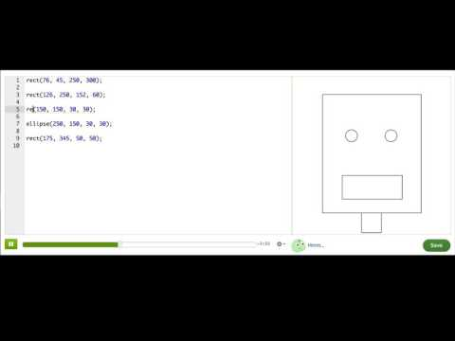
Drawing more shapes with code

Slide 7
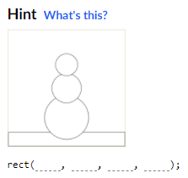
Practice: Waving snowman
We've drawn a snowman like you made in the first challenge, and now you're going to draw more shapes using the commands you just learned.
In this first step, use the rect() command to draw the ground, so that the snowman isn't just floating in air. You should add your rect() command before the ellipse() commands for the snowman, so that the snowman looks like he is in front of the ground.
Draw the ground

Slide 8
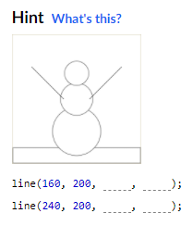
Practice: Waving snowman
Now you'll make it look like the snowman is waving by adding arms on both sides of his body, using the line() command.
You will need to add two line() commands, one for each arm. We've given you some suggestions for numbers in the hint code, but you can pick other numbers as long it still looks like arms. You should add your line() commands after the ellipse() commands for the snowman, so that the arms look like they are in front of the snowman.
Make him wave!

Slide 9
Resources
https://p5js.org/reference/

